Slide 1


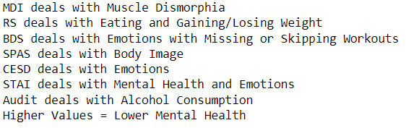
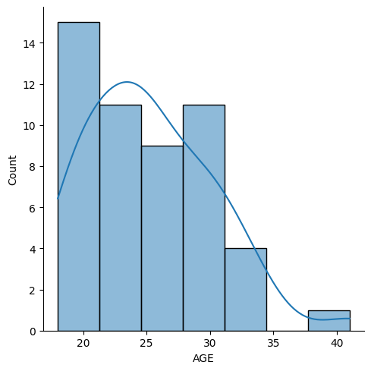
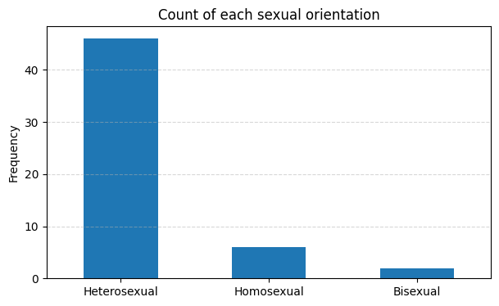
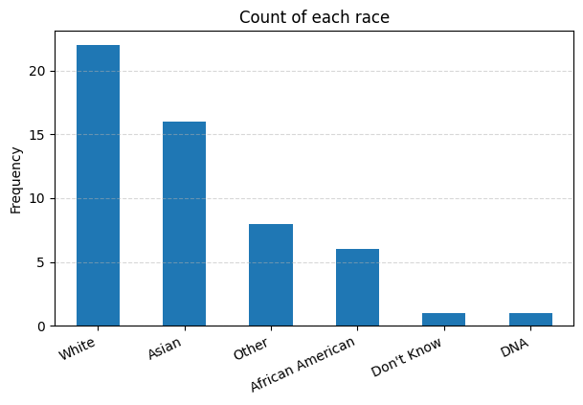
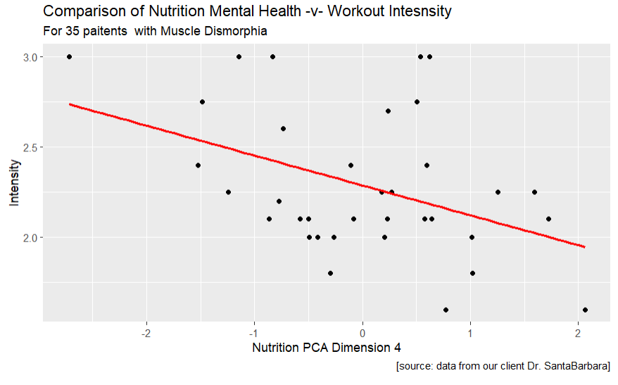
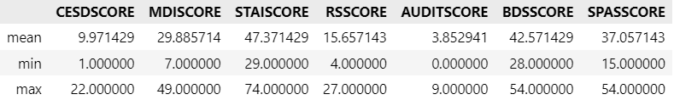
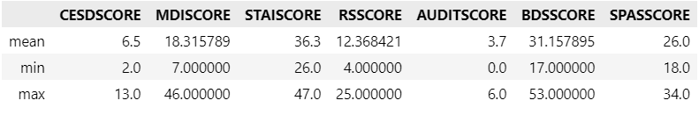
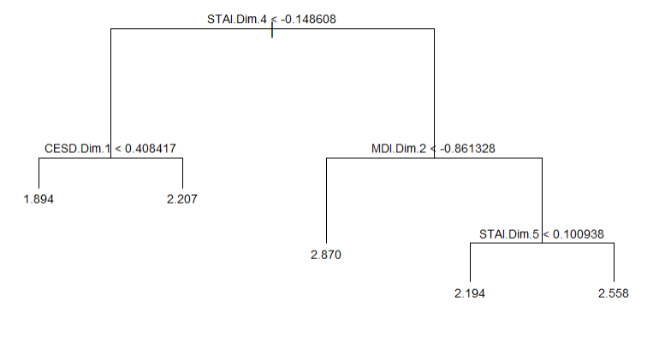
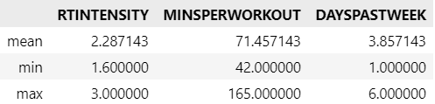
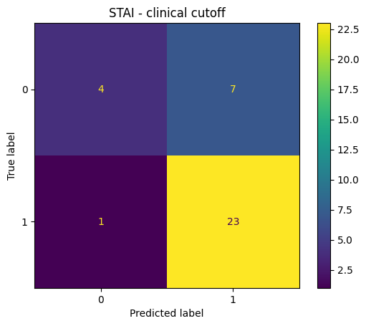
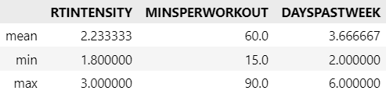
Identifying Muscle Dysmorphia
Author Ryan Canfield, Patrick Norcross, Alex Butera, Client: Dr. Nicholas SantaBarbara
Introduction/ Background
Data was Collected by Nicholas J. SantaBarbara, PhD, CSCS in survey fashion.
This study tested the acute psychological effects of resistance exercise in men with symptoms of muscle dysmorphia.
Twenty-one men completed 4 on-site sessions including a single session of moderate and high-intensity resistance exercise in a counterbalanced order separated by at least 48 hours.
State body image, perceived muscle size, exercise enjoyment, and ratings of perceived exertion (RPE) were assessed before, during, and after each session,
State body image significantly improve from pre to post during both sessions, with greater effect sizes seen for the high compared with the moderate intensity session.
Perceived muscle size improved from pre to post during the high-intensity only, and subjects enjoyed the high-intensity session significantly more than the moderate-intensity session, despite significantly higher RPE at each timepoint.
Results contend with previous findings that show more positive psychological effects of moderate-compared with high-intensity resistance exercise.
Data Set, Data Preprocessing, and Demographics
Data Set Information
Data was collected in surveys and questionnaires involving mental health. The data were in two seperate SPSS files that had used for other research papers. For our capstone project, we combined both files into one .csv file. Our final data set it contains a total of 33 rows and 159 columns. Each row represents a patent/survey member. The columns represents demographics, and questionnaire information.
Data Preprocessing
Step 1: We cleaned up the variable names and checked for consistency in variable names across datasets.
Step 2: We removed variables that did not appear in both datasets
Step 3: Changed row values to portray information in the same way.
Step 4: Merging the two data sets.
Step 5: Dropped participants that did not have Muscle Dysphoria because they were not our target group and had missing data.
Demographics of the data:
Materials and methods
Exploratory Data Analysis
Different graphs and tables were used to understand the data.
Principal Component Analysis:
PCA was used to limit the amount of features necessary for predicting training intensity.
ANOVA:
Used to predict mental health scale from substance and supplement use.
Logistic Regression:
Used to predict mental health status from substance and supplement use.
Linear Regression/Regression Trees:
Used to predict workout intensity based on the mental health scales.
Forward Stepwise Regression:
Used to pull out the most important features that predict intensity.
Regression Tree
Used to answer aim #2 in a non linear way.
Results for Aim #1
Characterize resistance training behavior, and mental health, in a sample of men with symptoms of muscle dysmorphia.
Individuals with Muscle Dysmorphia
Individuals without Muscle Dysmorphia
Individuals with Muscle Dysmorphia
Individuals without Muscle Dysmorphia
Results for Aim #2
Results for Aim #3
Explore any associations between mental health and substance and supplement use.
ANOVA Results:
Linear Regression Results:
Predicted Values of expressing symptoms of Anxiety.
.
Conclusions
Aim #1:
Mental Health: Based on our tables, Individuals with muscle dysmorphia shown higher levels of mental health scores, implying their mental health is worse.
Training Behavior: Individuals with muscle dysmorphia show very similar workout habits to those without muscle dysmorphia.
Aim #2:
Over all, these results show that the intensity of the workout is not associated with worse mental health, or having symptoms of muscle dysmorphia, due to poor performance of the models.
Aim #3:
R^2 values were generally low. This implies that the use of supplement and substance use is not a strong predictor of mental health in our sample.
Overall Conclusion
We were unable to come to any statistically significant conclusions regarding individuals with muscle dysmorphia specifically. However, we did uncover that those with MD do have worse mental health.
These Results do not represent the entire population of individuals with muscle dysmorphia.
Explore whether a worse mental health, including symptoms of muscle dysmorphia, are associated with more frequent and intense resistance training behaviors.
 | AUDIT | BDS | STAI
R^2 | 0.326 | 0.294 | 0.208
AIC | 154 | 237 | 270
 | CESD | STAI
R^2 | 0.082 | 0.121
Most significant variables from the PCA:
RS10: How many pounds over your desired weight were you at your max?
STAI8: I feel that difficulties are piling up and I cannot overcome them?
 | Linear on Scores | Linear on PCA | Forward Stepwise | Regression Tree
R^2 | 0.1363 | 0.2141 | 0.4712 | NA
Mean^2 Error | 0.3748 | 0.3534 | 0.2899 | 0.0543
Table Showing how well the models performed. For R^2 we want values as close to 1 and for MSE we want values as close as one.
Key Cited Literature
Acute Psychological Effects of Resistance Exercise in Men With Symptoms of Muscle Dysmorphia: A Pilot Study, 2022, Nicholas J. SantaBarbara, Sanaz Nosrat, James W. Whitworth, and Joseph T. Ciccolo, the Journal of Strength and Conditioning Research.
Acknowledgments
Thank you to our Data Science Professor Dr. St. Hilaire.
Notes:
‹#›

